Slide 1
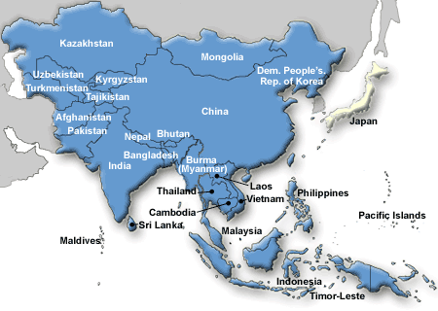
Unit 2 Asia
Modern History

Slide 2
Colonization
Colonization: is forced control of one nation by another nation to gain power, land, and RESOURCES!
Many countries from around the world saw Asia as weak and they wanted their resources. So they began taking them, or colonizing the land there.

Slide 3
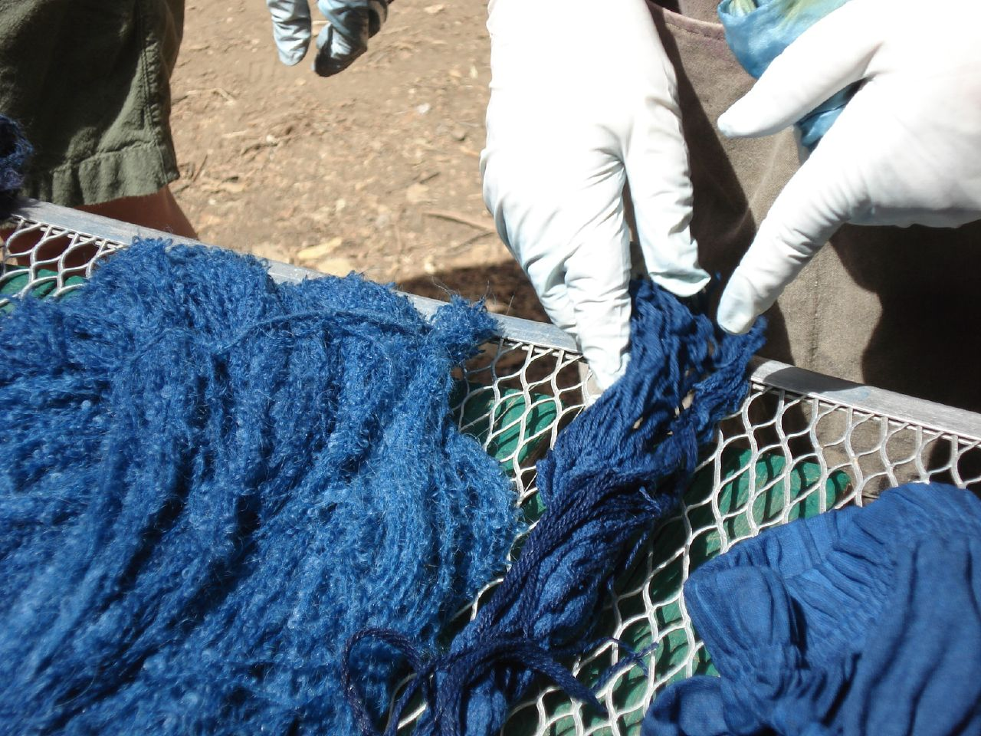
India
European Trading Companies
European’s began using India for their shipping ports
The Europeans started a company called the British East India Company
They came to India to trade for things like: Indigo & Spices

Slide 4
By the 1850s, the British East India Company: controlled almost all of India by using the ports on the coast for their ships to trade items with.
British put high taxes on Indians
Britain colonized and took over India
British wanted to get rid of Indian culture and make everything British
British had all the best jobs, all laws were British laws, not Indian
--India became a British colony in 1857
--It was mostly the upper Indian classes who benefited from the British as they were the landowners.
Indian peasants became increasingly poorer
Population increases hurt the food supplies and famines often made conditions worse

Slide 5
Development of Indian National Feeling
1885 the Indian National Congress was formed
  Indian National Congress was set up to help Indians gain more rights back from the British and indendence.
  This started feelings of Nationalism = feelings of pride towards your country.
  Nationalism eventually led to India’s independence!
--During WWI the movement went from being passive and patient to an aggressive and deadly one.

Slide 6
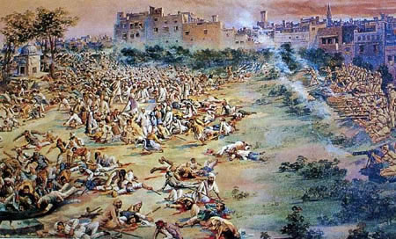

Slide 7
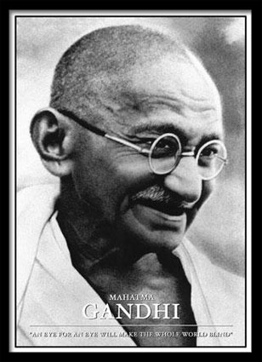
After WWII, European colonization began to crumble.
After WWII India’s fight for independence began to strengthen
For decades, Indians lived under the British Empire.
They suffered discrimination and horrible treatment in their own country.
Mohandas Gandhi was a Hindu who believed in non-violent protest as a means of gaining freedom from great Britain.
Gandhi is compared to
Martin L. King and Nelson Mandela
-----→India Gains independence in 1947!

Slide 8
New Tensions Arise in India after Independence:
*India gains independence from British in: 1947
*Indians began fighting each other over religion:
Hinduism and Islam.
**India is PARTITIONED into two countries to stop Hindu’s and Muslims from fighting.
**Hindu’s get India & Muslims get Pakistan.

Slide 9
India’s Government, Economy, & Today
-India has the world’s largest democracy & it operates as a republic, which means citizens vote for leaders.
It’s official name is: The Republic of India
India has a 2 house legislature (law makers)…that means it is
bi-cameral
-India has over 1 billion people living there
-India is working to improve it’s economy
-India has a MIXED economic system (mostly market)
*India has a literacy rate (ability to read & write) of 61%--Very Low! This means that the standard of living in India is low, with a lot of poverty.

Slide 10
JAPAN!!!

Slide 11
JAPAN!!!
--Japan was on the losing side of WWII & they were the USA’s enemy at this time.
--Japan bombed a US naval base at Pearl Harbor, Hawaii. We were not fighting in the war at the time.
--USA joined forced against Japan in WWII after Pearl Harbor bombing
--USA dropped an atomic bomb on Nagasaki & Hiroshima during WWII in 1945. This RUINED Japan’s economy, killed thousands, & led them to losing WWII.

Slide 12
Facts about the Dropping of the Atomic Bomb on Hiroshima ---YOU DON’T NEED TO WRITE THIS DOWN!
On August 6, 1945, the U.S. dropped an Atomic Bomb on the city of Hiroshima, Japan.
60,000-80,000 people died as a direct result of the bomb blast.
About 100 square miles of the city was completely destroyed.
Over the next 10 years, 40,000 people died as a result of injuries from the bomb or radiation poisoning.
On August 7, 1945, the U.S. demanded Japan surrender immediately and unconditionally.
On August 9, 1945, the U.S. dropped a second Atomic Bomb on Nagasaki, Japan.

Slide 13
Rebuilding japan…
Japan was a disaster after the 2 bombings & losing WWII.
The USA helped Japan rebuild after WWII ended. We helped their citizens and government get back on track.
USA made a new constitution for Japan and new laws.
Japan was forced to give back control of the Koreas.
Japan had to rebuild everything that was ruined during the bombings
USA had control of Japan until 1951

Slide 14
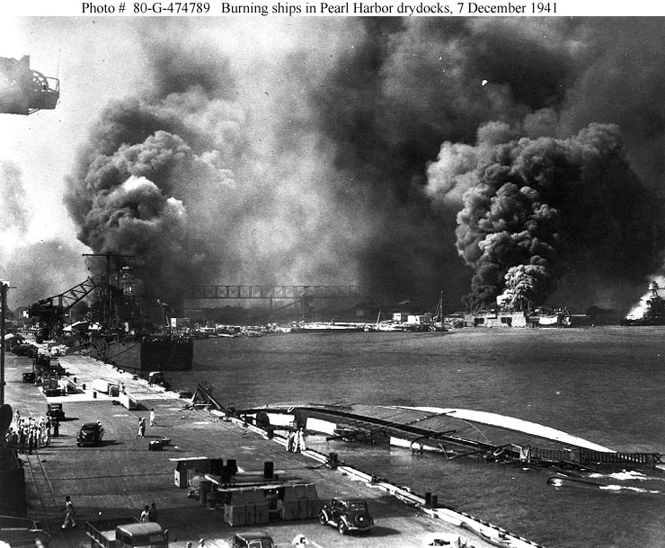
Pearl Harbor Bombing- 1947

Slide 15
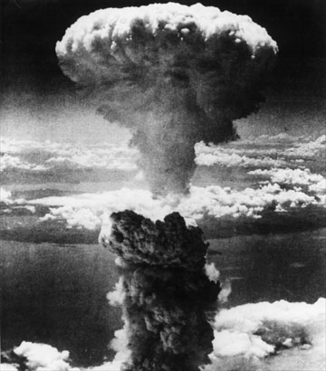
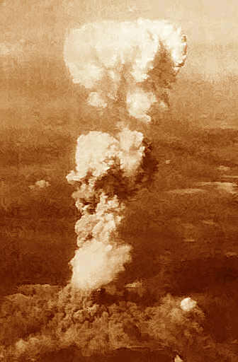
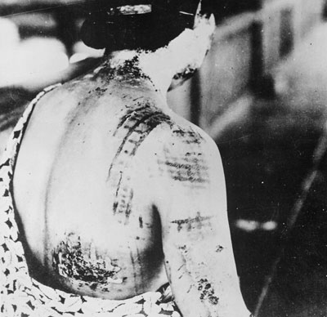
Nagasaki & Hiroshima Bombings in Japan

Slide 16
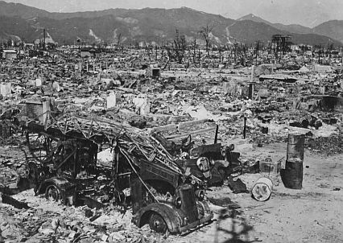

Slide 17
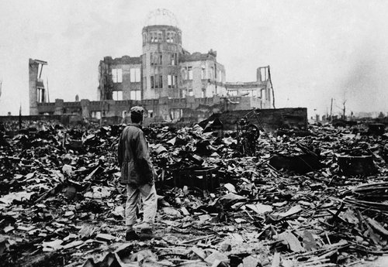
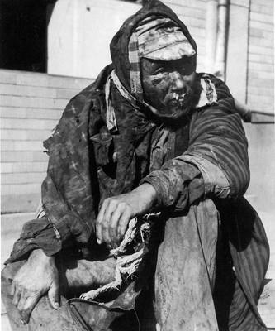

Slide 18
Japan’s Gov’t, Economy, & TODAY!
Japan imports most food products because they are such a small island
They make a lot of technology and export it
Japanese are very dedicated to school and smart!
Japan’s government is a Constitutional Monarchy (they have an emperor but he makes no choices). PEOPLE CAN VOTE!!!
Japan’s legislature (law makers) is called the DIET→THE DIET VOTES FOR THE LEADER!

Slide 19
Japan Today Continued…
Japan has mixed economic system (mostly market).
High literacy rate of 99%
High standard of living
One of the best economies in the world !
Strong work ethic
Focus on fish and technology!
Imports most of the food people eat

Slide 20
The Cold War
**War of words between USA and Soviet Union right after World War II ended.
**Soviet Union supported Communism and the USA did not.
**The 2 countries became enemies.

Slide 21
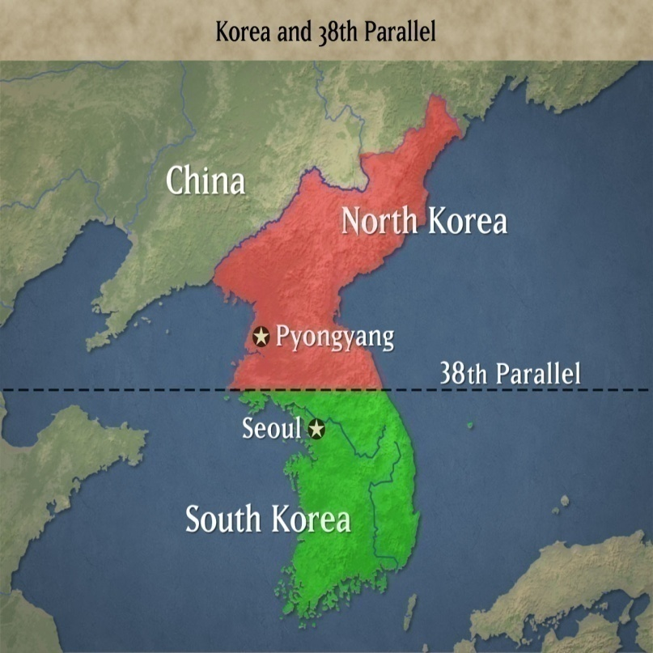
The Koreas
The Soviet Union and the US helped Korea gain it’s independence, the country was divided along the 38th parallel (or the DMZ) (line of latitude running through Korea).
North Korea became a communist country (with help of Soviet Union)
**South Korea become a democratic country (with help of USA)
In 1950, the Korean War began because North Korea invaded South Korea.
The United Nations sent troops to help South Korea.

Slide 22
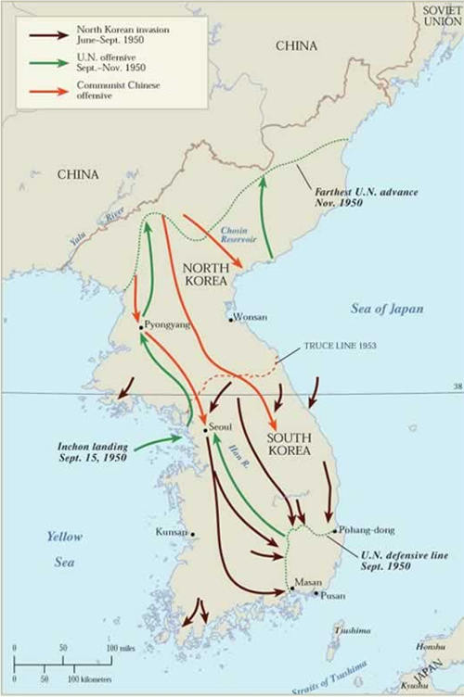
U.N. forces pushed the North Koreans all the way back to the northernmost parts of Korea.
Things changed again, however, when Chinese troops crossed the border to help North Korea.
A stalemate soon developed, in which *Neither side won
Both sides signed a cease-fire in 1953 that left the country divided at almost the exact same point as it had been before the war.

Slide 23
Today North & South Korea are separated at the 38th Parallel by a fence, known as the Demilitarized Zone (DMZ).
The DMZ is guarded on both sides by NK troops & SK troops.
No one is allowed in or out of North Korea today.

Slide 24
North & South Korea Today!
Today, tensions remain high between North and South Korea.
A Market economy and democracy have allowed South Korea to thrive as a wealthy, modernized society.
North Korea is one of the poorest nations in the world.
Its strict communist government puts most of the nations resources into its military rather than on efforts to modernize and benefit the population.

Slide 25
North & South Korea continued..
Communism is the main problem in N.Korea today.
Communism: The goal is to have a classless society with no rich or poor—everyone is supposed to be equal BUT it DOES NOT work this way.
North Korea wants South Korea to be communist, and South Korea wants North Korea to be a democracy.
Neither side is willing to negotiate to come together as one Korea

Slide 26
North Korea
For 40 years, North Korea relied on its two giant neighbors, the Soviet Union and China, for political, economic, and military assistance- but no longer has ties to either country .
-North Korea is not friends with many other countries
North Korea has a Communist Government & a Command Economic System
North Korea is led by a dictator, Kim Il Sung until his death; now his son, Kim Jong Il rules
North Korea is rich in mineral resources
North Korea is believed to have several nuclear weapons able to reach South Korea and Japan.

Slide 27
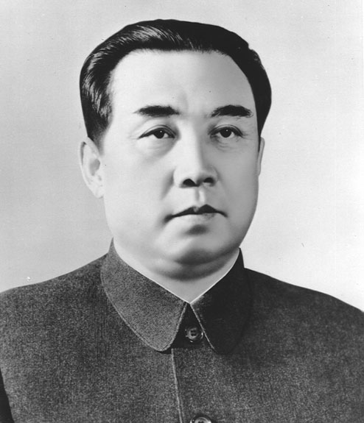
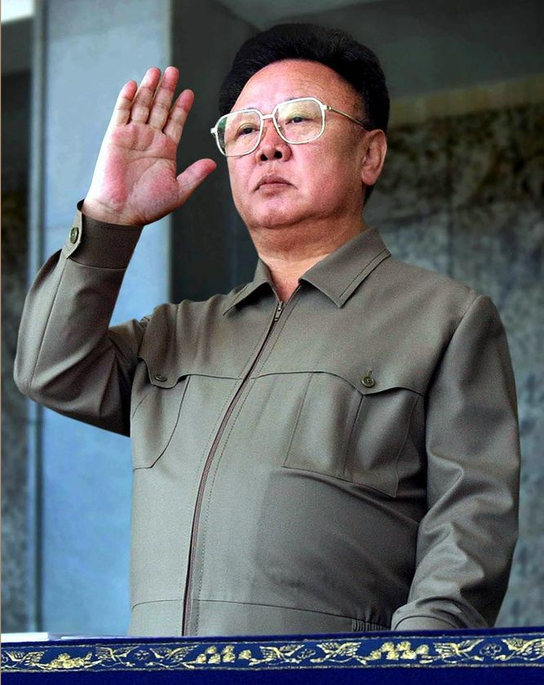
Kim Il Song
Kim Jong Il

Slide 28
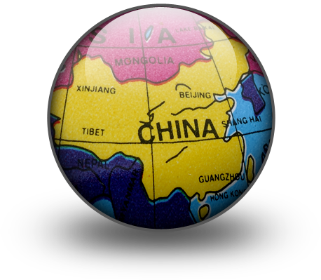
CHINA!

Slide 29
CHINA!
The Chinese Republic was set up in 1911 when it the dynasty rule in China came to an end.
The first ruler was Dr. Sun Yat-Sen; “the Father of the Chinese Revolution”
Dr. Sun spread the idea of democracy in China. He thought that the Chinese people should have a government “of the people, by the people, and for the people”
In 1912, he set up the Kuomintang.
Kuomintang – The movement founded by Sun Yat-Sen to make China a modern democratic republic.

Slide 30
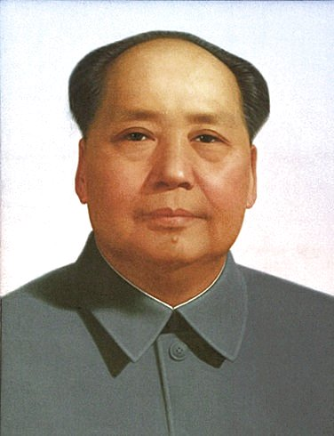
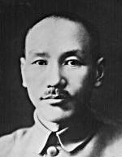
Chiang Kai-shek Rules China
1926 - Chiang Kai-shek, a nationalist, took over China.
His only enemy was Mao Zedong and the Communists
In 1934- Chiang and his Kuomintang army surrounded and forced Mao Zedong and his Red Army to walk back to the western side of China known as the Long March, many communists died along the way-and Mao was angered
A civil war broke out in which Mao (Communists) defeated Chiang Kai- shek (Nationalist). The result of this was: CHINA BECAME COMMUNIST!!!
            Chiang Kai-shek and his nationalist were forced to flee to Taiwan where they still rule today

Slide 31
Mao Zedong and the Peoples Republic of China
The communists, under Mao Zedong, came to power in 1949 as a dictator!
Communism: when the government (one person CONTROLS EVERYTHING!). People have no rights.
Mao wanted to totally change Chinese civilization.
He said he wanted equality among all people &(no social classes) but it did not work this way
China became completely COMMUNIST!
Mao became “God-like” in China with posters of
him and propaganda everywhere.

Slide 32
The Great Leap Forward
Mao wanted to modernize China.
He wanted to build factories to strengthen the country after decades of war.
In 1958, he launched the Great Leap Forward.
The Great Leap Forward was Mao’s idea to help China’s economy. Forced people to farm and share all food & created more factories so they could produce more things!
It involved thousands of Chinese citizens living together in communes (where people live together & share everything).
The Great Leap Forward was a huge failure—known to many as the Great Leap BACKWARDS. This RUINED China’s economy and killed millions.
Floods, droughts, bad management, and corruption ruined China and left millions dead of starvation.

Slide 33
The Cultural Revolution
This began in 1966 and ALSO ruined China!
Thousands of people lost their lives during this time of chaos and violence
Since The Great Leap Forward failed, many people, especially the intellectuals, became opposed to Mao
Mao decided to change things and get rid of those who opposed him: teachers, students, scholars, and scientists.
Mao organized a group of 11 million young people into the “Red Guard” (his communist army)

Slide 34
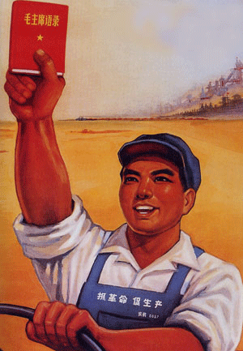
Mao placed the Red Guard all over the country where they violently attacked people and things that represented the “old way”
Schools and universities were closed for several years.
In 1968 Mao called an end to the Red Guard by sending them to help out on the farms.
Mao still had all of his power but China’s economy, education, and agriculture was a DISASTER! .

Slide 35
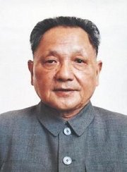
China Under Deng Xiaoping
Mao died in 1976 (old age) and Deng Xiaoping took over as the leader of China
Deng brought about major social and economic changes to China
Deng introduced elements of a market economy (owning your own business) and allowed more personal freedoms—but not a lot.

Slide 36
Political Changes
Deng made sure Mao was no longer treated like a god.
Deng Xiaoping got rid of the leaders (communists) who supported Mao
He wanted to get more educated people in the government
Economic Policy
All major industry was still run by the government but Deng allowed individuals to own small shops
He encouraged trade with the West for more technology

Slide 37
In 1979 China announced the “one-couple, one-child” policy.
  Couples who agreed to have only one child got better housing, free medical care, and pay increases.
Those who did not were fined, had their salaries reduced, and even lost their jobs.
The policy met with much resistance because it conflicted with the Chinese tradition of having many children,
Rural families argued that sons were needed to work the fields to produce the food demanded by the government.
The policy has had a serious effect, especially on girls, & has created a large orphan problem in China

Slide 38
The Massacre at Tiananmen Square
In the spring of 1989 students began to meet at Tiananmen Square in Beijing - which is the largest square in China
The students wanted greater freedom, and end to corruption,and more human rights-most were educated outside of China- where people could think freely & had human rights
The government saw the protesters as a threat to their rule and threatened to strike at them but the students refused to go
The whole world watched all this on the news.
Chinese troops came and killed around 1,000 of the demonstrators
Though Deng allowed greater economic freedoms, there were never any political freedoms

Slide 39
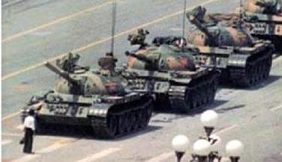

Slide 40
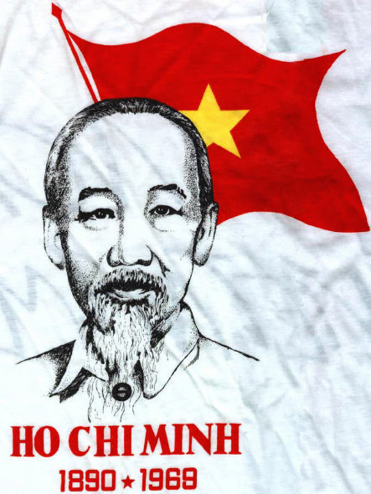
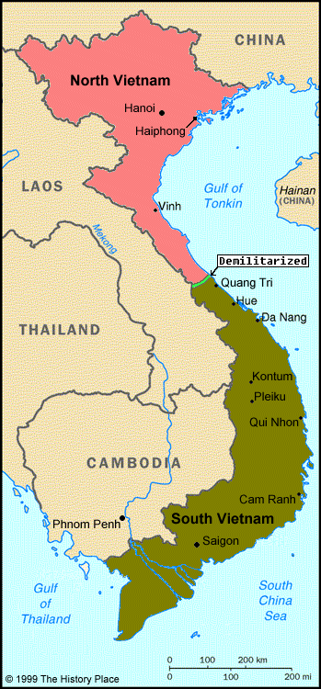
VIETNAM
After WWII a new leader came to power in Vietnam,
named Ho Chi Minh.
USA did not like Ho Chi Minh because he was
communist…dictator!
In 1954, Vietnam and Western powers partitioned Vietnam into North and South
North Vietnam became communist under Ho Chi Minh, while the US helped South Vietnam.

Slide 41
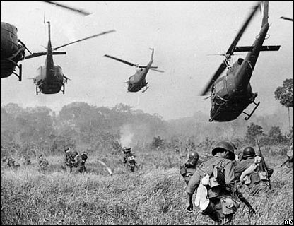
The Vietnam War
North & South Vietnam broke
out in war.
The US sent military to help fight against the communist
DOMINO THEORY: The US feared that communism would spread throughout all of Eastern Asia if South Vietnam lost.
USA joined Vietnam War to STOP communism!!!

Slide 42
The USA lost the Vietnam war for the following reasons:
No support at home
Didn’t know the geography
Communist used guerilla war tactics
South Vietnam did not completely support USA
DRAFT!
The US was fighting North Vietnam’s invading army, AND the South Vietnamese communists known as the Viet Cong.
The Viet Cong consisted largely of poor rural farmers
the Viet Cong and North Vietnamese launched an effective guerilla war.

Slide 43
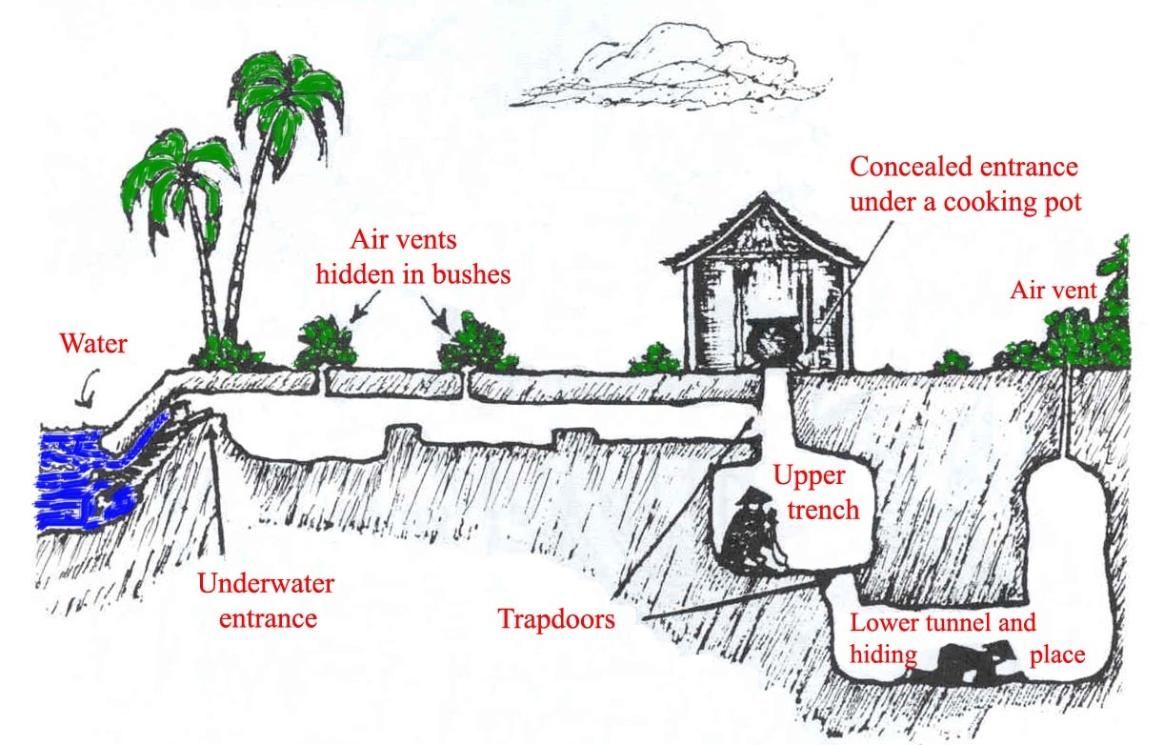
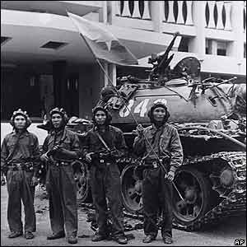
END OF VIETNAM WAR
As years passed and more and more US soldiers died in Vietnam, guerilla warfare eventually succeeded.
In 1973, the US formally ended its military involvement in Vietnam.
It signed an agreement known as the Paris Peace Accords.

Slide 44
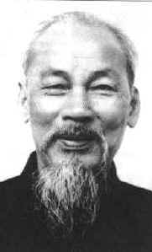
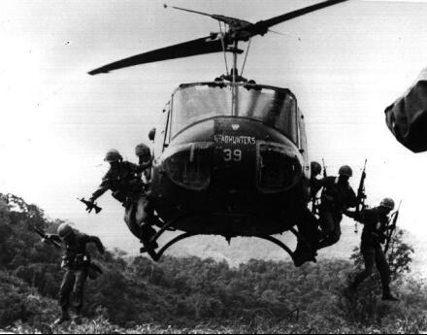
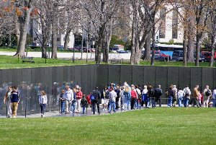
Under this treaty, the US pulled out its remaining troops, and South and North Vietnam agreed to exist peacefully alongside one another.
When USA left Vietnam, the communist began fighting again.
In April 1975, the South Vietnamese capital of Saigon fell.
The Communists won and North & South Vietnam were united into one COMMUNIST country known as Vietnam

Slide 45
The USA lost the Vietnam war for the following reasons:
1.No support at home
2. Didn’t know the geography
3. Communist used guerilla war tactics
4. South Vietnam did not completely support USA
5. DRAFT!
From the topics below pick ONE that you strongly believe made the USA lose the Vietnam War. You need to write your name at the top of your paper and the topic you choose. Then write one paragraph explaining WHY you believe the topic you chose caused the USA to be unsuccessful in the Vietnam War.

