Slide 1
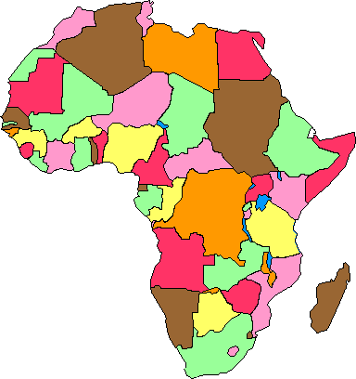
Africa – Unit 2
REVIEW
GAME!!!

Slide 2
In the Sahel, overgrazing and drought have resulted in a decrease in the grassland region. What is this process called?
DESERTIFICATION

Slide 3
What does partition mean?
to divide

Slide 4
During the 1950’s and 1960’s most African countries experienced what?
Political Independence from the
European Powers

Slide 5
What was the name of the meeting which called for the partitioning of Africa in the 1880s?
The Berlin Conference

Slide 6
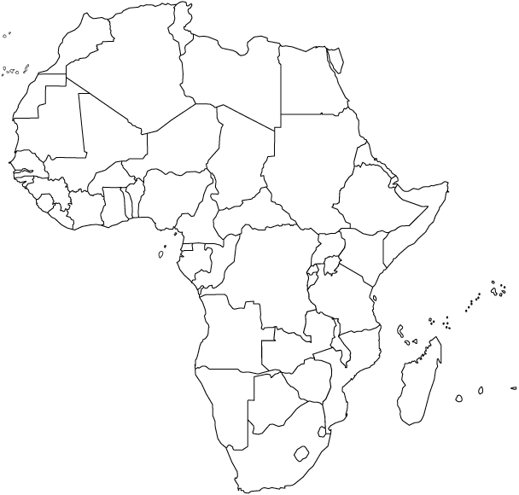
NIGERIA
What country is this?

Slide 7
What role did Mandela and de Klerk play in the evolution of Apartheid in South Africa?
They worked together to abolish Apartheid.

Slide 8
SUDAN
What country is this?

Slide 9
Why did Africans want independence from European powers?
They wanted control of their own governments & resources.

Slide 10
EGYPT
What country is this?

Slide 11
What lake is this?
LAKE VICTORIA

Slide 12
What leader is responsible for making Apartheid illegal?
F.W. de Klerk

Slide 13
What River is this?
CONGO RIVER

Slide 14
What ethnic group lives in Central & Southern Africa?
Bantu

Slide 15
Why did Europeans build empires in Africa?
Europeans wanted the natural resources found there, and to expand their empires.

Slide 16
What River is this?
NILE RIVER

Slide 17
SOUTH AFRICA
What country is this?

Slide 18
What religion is most common among the Swahili today?
Islam

Slide 19
KENYA
What country is this?

Slide 20
What River is this?
NIGER RIVER

Slide 21
What is the reason for the many different languages found in Africa?
Because there are many ethnic groups that each speak their own language.

Slide 22
A war fought in a country with it’s own people fighting each other is called a _____.
civil war

Slide 23
When did many African groups begin to challenge European colonial rule?
After World War II

Slide 24
Who was the president who helped bring an end to Apartheid in South Africa?
Frederick W. De Klerk

Slide 25
What movement stressed that all black Africans must see themselves as one people?
Pan-Africanism

Slide 26
What is the name of Nelson Mandela’s political party?
African National Congress

Slide 27
During the late 19th and early 20th centuries European powers raced to colonize the African continent, this became known as the…..
“Scramble for Africa”

Slide 28
What rights were removed under Apartheid?
Race Mixing
Free Travel
Voting
Free Speech
Citizenship

Slide 29
What were some of the requirements for black Africans under Apartheid?
Forced to live in homelands
Required to use separate facilities from whites
Required to carry pass books

Slide 30
Poor soil & deforestation causes land to become what???

Slide 31
Which African country had Apartheid?
South Africa

Slide 32
What was the main goal of the Pan African Movement?
To get all Africans around the world to think of themselves as one people and to begin to work together for independence & economic/political stability

Slide 33
Mandela was president of what organization that worked to end Apartheid?
The ANC or
African National Congress

Slide 34
What did the African nationalist movement fight for?
INDEPENDENCE

Slide 35
What mixed ethnic group mostly live in North Africa & the Middle East?
ARABS

Slide 36
The word Apartheid comes from what language?
Afrikaans

Slide 37
The development of the Swahili language was a direct result of what?
The mixing of the Bantu, Arabic, and other traditional African languages.

Slide 38
What ethnic group lives in central Ghana, and believes that the strength of their nation depends on the “Golden Stool?”
The Ashanti

Slide 39
What mountains are these?
ATLAS MOUNTAINS

Slide 40
Bantu and Arabic
The develop of the Swahili language was the result of the mixing of which two cultures?

Slide 41
In what geographic region of Africa would I find the Niger River AND what impact would the fertile soil along this river have on the population there?
Western Africa...increased population
(makes it the population center of Africa).

Slide 42
In what country are both the Tigris and Euphrates Rivers found?
Iraq

Slide 43
What is Zionism?
Zionism is a movement whose goal was to establish a Jewish homeland in Israel.

Slide 44
What is the USA’s main economic interest in Southwest Asia
(the Middle East)?
OIL

Slide 45
To what does the term Anti-Semitism refer?
the prejudice and hostility shown toward Jewish people

Slide 46
What is the role of OPEC?
It monitors oil supply and demand to set the price of oil.

Slide 47
Which ethnic group would be found in Turkey, Iraq, Iran, and Syria?
Kurds

Slide 48
What lake is this?
LAKE TANGANYIKA

Slide 49
In 1990-91 the USA sent troops to the Middle East to free which country?
Kuwait

Slide 50
Persian people are closely tied to which country?
Iran

Slide 51
What is the difference between an ethnic group and a religion group?
An ethnic group is a group of people who share cultural ideas and beliefs that have been part of their community for generations, where as a religious group is a group of people who share a belief system in a god or gods, with a specific set of rituals or ceremonies.

Slide 52
What organization created a new state of Israel in 1948, as a homeland for Jews?
The United Nations

